Slide 1




Taking a Stand: Before Speaking Out, Look Inward
FPRA – Capital Chapter
Gabriel Sanchez, First 5 LA
July 16, 2020

Slide 2
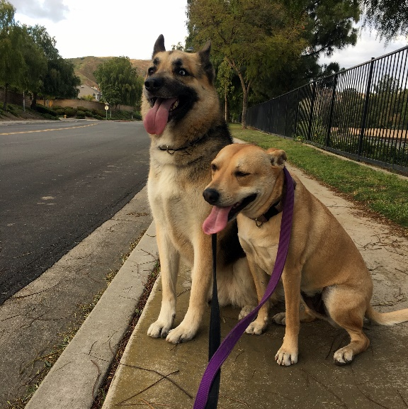
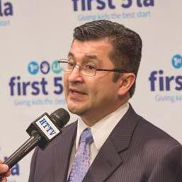
About Me
I’m Gabriel Sanchez.
A Storyteller
A Dog Person
Passionate About Sharing Ideas
Have Work/Life Integration
Image
Image
@First5LA @ItsGabeSanchez
Notes:
Hi there. I’m Director of Communications at First 5 LA, an independent public agency that advocates for kids prenatal to age 5. We also fund innovative programs to boost early childhood development.
My work at First 5 LA helps me as a parent. The situations I experience raising my daughter help inform my work.
As a Dad, my work hat at First 5 LA helps me to be the best parent I can be. And the situations I experience raising my daughter serve to inform my work. I enjoy true work/life integration.
And I’ve always been able to use storytelling: from talking my way out of a ticket, to persuading my daughter to eat her veggies. At First 5 LA I get to tell stories for a greater purpose — elevating the voice of parents, and backing it up with data to show the big picture — using strategic communications to make a greater impact for young kids.
Now, I’m sharing stories about the issues young children and their families face to help influence elected officials and decision makers to prioritize kids in policy and funding discussions. And I’m using communications to help build a community of parents in L.A. County who can share their collective expertise with new parents.
Our children are our future. At First 5 LA, I get to make it as bright as possible for my family, and for families throughout the County.

Slide 3

About First 5 LA
Public agency created by voters in 1998, funded exclusively by a tax on cigarettes
Focused on kids prenatal to age 5
Prioritizing kids because 90% of the brain is developed by age 5
@First5LA @ItsGabeSanchez
Notes:
First 5 LA is an independent County agency in Los Angeles that advocates on behalf of parents with young children to help every child, prenatal to age 5, be healthier, safer and better prepared for kindergarten.
Knowing that 90% of a child’s brain is developed by age 5, First 5 LA provides funding for parent coaches to visit newborn babies and their parents in their homes, supports parents who are trying to make their neighborhoods better for families, helps early childhood educators get the training they need, and shares parenting tips and resources.
We partner with other county agencies and organizations to help parents. They also work with elected officials to prioritize funding for early childhood education, health care and other programs that young children and their parents need.
Births
There are approximately 640,000 kids 0-5 in LA County.
There are approximately 123,000 kids born in LA County in each of the last two years.
Only 4.4% of births in LA County are to Teen Mothers (ages 15-19).
Roughly 4.7 babies per 1000 births die before the age of one. This rate is twice as high for African American babies.
Demographics
Approximately 182,000 children (0-5) live in poverty in Los Angeles County.
Children born in low income families are exposed to 30 million fewer words by the age of three than their more affluent peers.
Development
80% of a child’s brain develops by the age of 3
90% of the child’s brain develops by age 5
There is a 13% return on investment for every dollar spent on quality early childhood programs for disadvantaged children.
Health and Well-Being
Approximately 96% of children (0-5) in Los Angeles County are covered by health insurance.
Approximately 90% of all entering Kindergartners begin school with their required immunizations.
Approximately 25% of 3 and 4 year olds in Los Angeles County are overweight or obese.
Children (0-5) are hospitalized for Asthma at twice the rate of any other age group.
About 6 in 10 mothers in LA County exclusively breastfeed their children.
Early Care and Education
Six in ten parents with children (0-5) report reading to their children every day.
On average families spend roughly $13,000 per year for their child to be cared for in a licensed Child Care Center.
Slightly more than 3 in 10 children ages 3-5 are not enrolled in preschool or transition K.
Child Safety
Infants under 1 make up 19% of the Foster Care entry population in LA County.
Children under the age of 5 make up 45% of the entire Foster Care population in LA County.
For children born in 2006 nearly 15% were referred to DCFS for possible abuse and neglect at some point before the age of 5.
Investment
Since its inception, First 5 LA has invested approximately $1.8 Billion dollars to improve outcomes for children (0-5) and families in Los Angeles County

Slide 4


Taking a Stand
Before you speak out on a polarizing issue, look inward and ask the following questions to help frame your stance, build your credibility and achieve your goals:
What is your reason for speaking out?
Will your existing audiences be receptive to your stance?
What is your history on the issue?
What do you hope to accomplish?
@First5LA @ItsGabeSanchez

Slide 5
    How This Can Fit Your Strategies
Like it or not, everyone is a spokesperson
Use a “pre-crisis” mindset
Respond, pivot and adapt
There’s a connection to your stand and your mission
@First5LA @ItsGabeSanchez

Slide 6


When Taking a Stand Goes Wrong
Starbuck’s #RaceTogether campaign
Nike’s “Dream Crazy” campaign
Poetry Foundation
And on, and on…
@First5LA @ItsGabeSanchez
Notes:
The Poetry Foundation announced on Wednesday that its president and board chairman are resigning, several days after an open letter signed by more than 1,800 poets and others criticized the foundation’s recent statement on the Black Lives Matter movement and called for them to be replaced.

Slide 7
Things to Remember
Be honest, with yourself, and your leadership
Be authentic with your audiences
Be vulnerable, let your audiences influence your actions
Ask questions, listen, learn and apply
@First5LA @ItsGabeSanchez

Slide 8
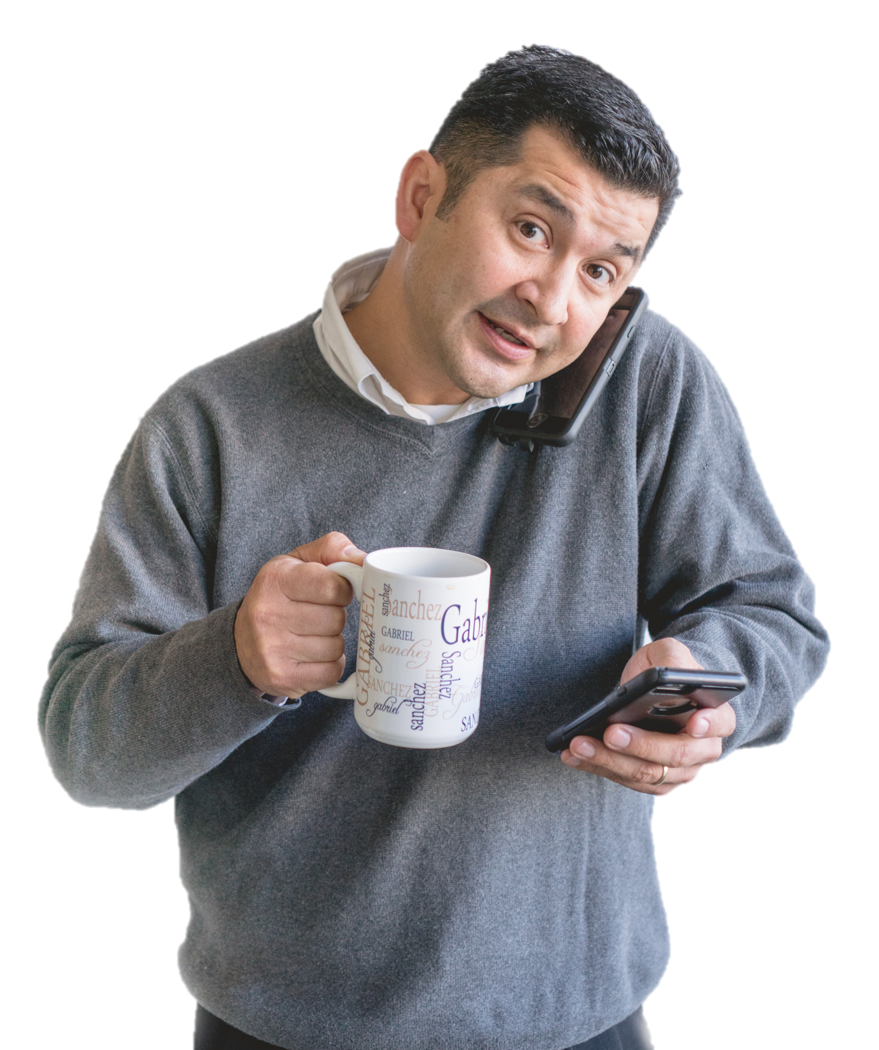
Questions?
Call me at 213-482-7804 gsanchez@first5la.org
@itsgabesanchez www.linkedin.com/in/gabrielsanchez www.first5la.org

Slide 9

THANK YOU!
@First5LA @ItsGabeSanchez

